Slide 1

I
SIX WEEKS SUMMER TRAINING
on
Student Attendance Marking System using OpenCV (Python)
Submitted by
(Anish pathak)
Registration No. - 12013516
Program Name: Advance Data Structure and Algorithms
Under the Guidance of
Chandan Mukherjee
School of Computer Science & Engineering Lovely Professional University, Phagwara
(June-July, 2022)

Slide 2
DECLARATION
1.
I hereby declare that I have completed my six weeks summer training at EXETELLON from 28th of June to 29th of July under the guidance of Chandan Mukherjee. I have declared that I have work with full dedication during these six weeks of training and my learning outcomes fulfill the requirements of training for the award of degree of BTech, Lovely Professional University, Phagwara.
Anish Pathak
Registration no: 12013516
Date: 17th July 2022

Slide 3


Slide 4
Table of Contents:
Page No.
Acknowledgement
5
Introduction & Project Objective
6
Hardware /Software Requirements
7
Application workflow(Flowchart)
8
Modularization Details
9-18
Testing and Validation Check
19-24
Code
25-41
Conclusion
Future Scope of Improvements
42
43

Slide 5
Acknowledgement:
I take this opportunity to express my profound gratitude and deep regards to my faculty (Chandan Mukherjee) for his exemplary guidance, monitoring, and constant encouragement throughout the course of this project. The blessing, help and guidance given by him/her time to time shall carry me a long way in the journey of life on which I am about to embark.
I am obliged to my project team members for the valuable information provided by them in their respective fields. I am grateful for their cooperation during the period of my assignment.

Slide 6
INTRODUCTION & PROJECT OBJECTIVE:
This project is made in accordance with developing an intelligent application system that uses face detection and identification to assist in marking of attendance in any establishment. The system requires a video capture device and a face-recognition module to be implemented successfully. It detects the faces and mark attendance accordingly with time and date . All the records will be recorded and get updated time to time in a CSV file. This system will prevent unnecessary wastage of time of classes that is usually wasted in form of class roll calls. Additionally, to offer a user-friendly GUI and a variety of accessible features that make handling and configuring the system for the user simple and effective.To develop a platform where students can easily view and take their attendance.
It can be generally used in Educational Institutions.

Slide 7
Hardware-software requirements:
PC /Laptop
16GB Micro SD Card
Power Supply
WebCam with good mega pixels
Jupyter Notebook for coding in Python Language
OpenCV Library
Numpy
Tkinter GUI
Face_recognition module
Image dataset
Data Storage in CSV file

Slide 8
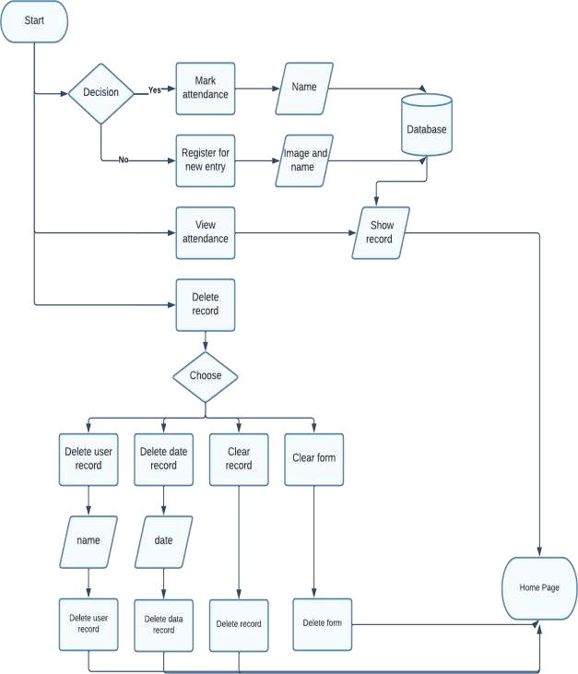
Application workflow:

Slide 9
Modularization details and Overview of the Project:

Slide 10
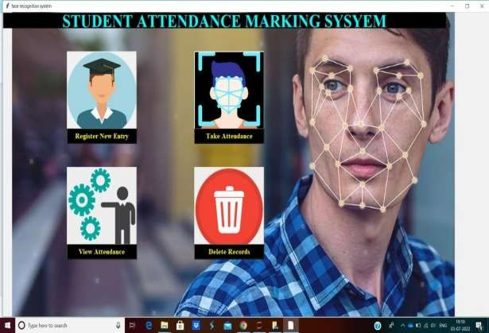
GUI Window1 (Home Page):
This will be our first screen when program will start.All these GUI windows will be created using Tkinter library of python.
An Attendance Form Icon will be present there inside the page along with some buttons mentioned below;-
Contains - (i)
(ii)
'Register for new entry' button
'Take Attendance' button
'View Attendance Form' button
'Delete record in Attendance Form' button
'Exit'- This will terminate the program

Slide 11
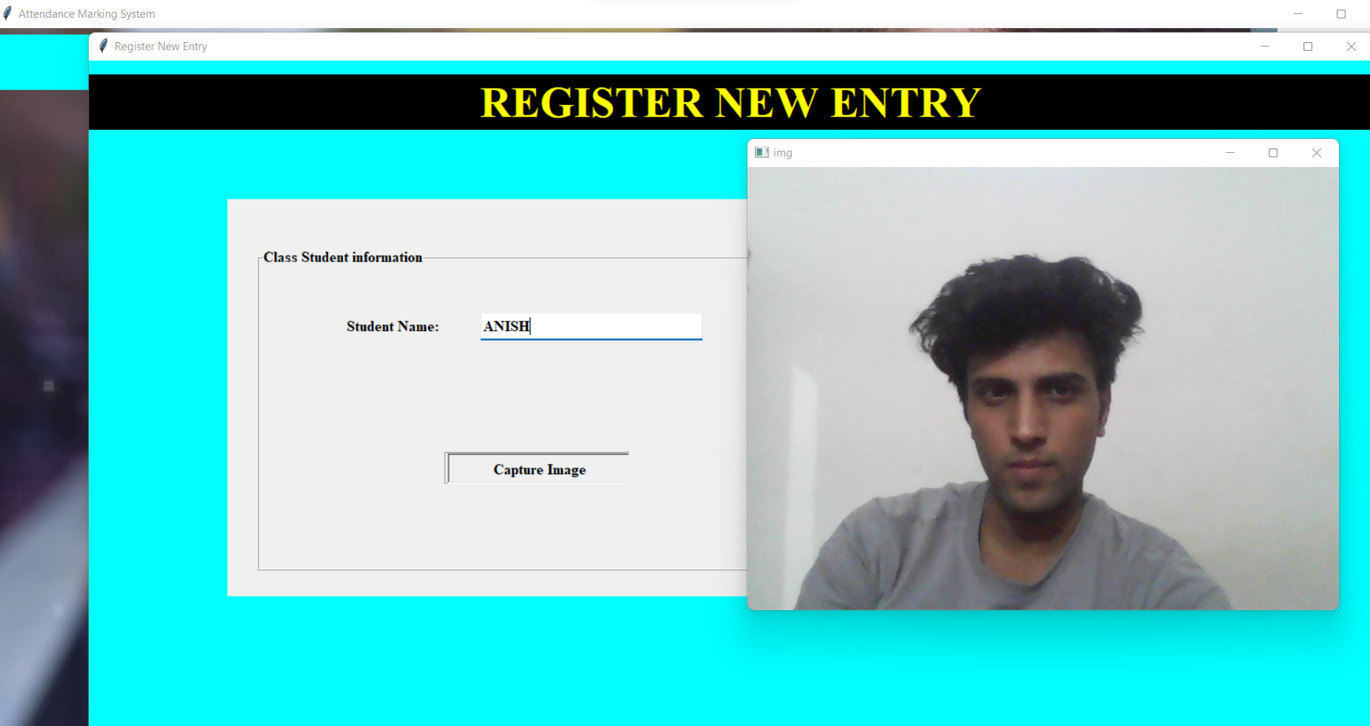
GUI Window2 (Register for New Entry)
This window will open after clicking 'Register for new entry' button on Home page)
Contains -(i) User input for 'Name' in Label field (ii)'Capture Image' button
Purpose - If 'Capture Image' button is clicked , WebCam will automatically get opened[using OpenCV library] and takes photo of user and then presents that image on screen .
User will then receive a message to select 'Take Another Photo' or 'Continue with this photo'[using messageBox function]
If user clicks first option ,then the current page will reload again without saving anything or else if user selects second one then the the ‘name’ data will be saved as new row entry and get updated in csv file and the captured image will get saved with ‘jpg’ extension in a new directory named as ‘Image Dataset’.
{There will be a button at the end to return on Home Page}

Slide 12
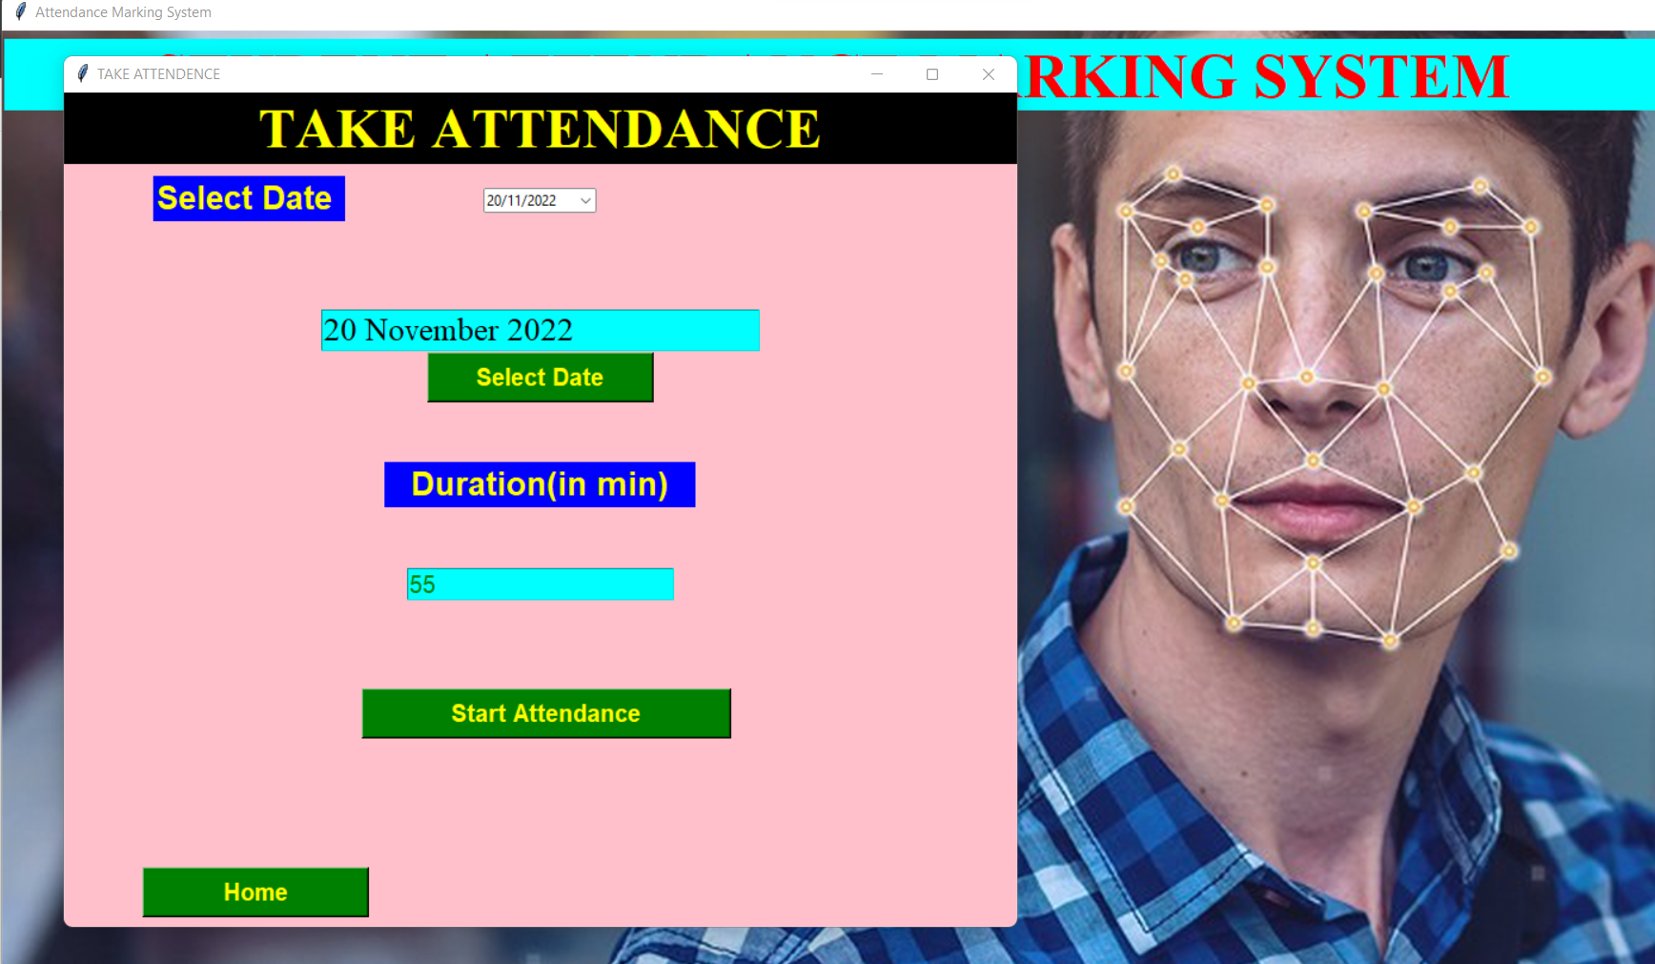
GUI based Window3 (Take Attendance)
This window will open after clicking 'Take Attendance' button on Home page)
Contains - (i) User input for 'date' in Label field ( to create new ‘date’ column in CSV file) [Tkcalender library is used to take input from calender]
User input for 'time' in Label field (for time uptill which the form will remain open)
'Start Attendance' button.(If user clicks this, WebCam will get opened for the specified time and the particular person will be marked present and get updated in CSV file accordingly.)
{There will be a button at the end to return on Home Page}

Slide 13
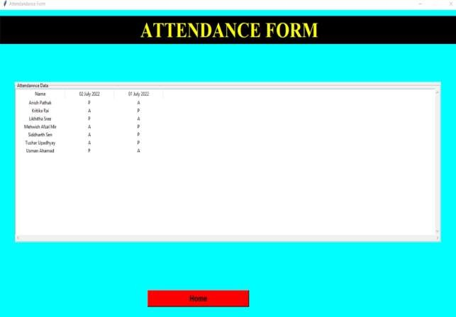
GUI Window4(View Attendance Form)
This window will open after clicking 'View Attendance Form' button on Home page.
Purpose - This window will just show the contents of CSV file on screen.
{There will be a button at the end to return on Home Page}

Slide 14
GUI Window5
('Delete record in Attendance Form’)
This window will open after clicking 'Delete record in Attendance Form' button on Home page.
Contains - (i) 'Delete a user record' button(Removing the row with
the particular 'name' from CSV file)
{ After clicking this, a message box will appear to specify 'name' for deletion.On hitting 'enter' ,particular 'name'row will get deleted from CSV file}
'Delete a specific date's record' button(Removing all entries of a particular date)
{After clicking this,a message box will appear to specify 'date' for deletion.On hitting 'enter' ,particular 'date' column will get deleted from CSV file}
**Note - tkcalender needs to be used to take user input for
date
'ClearAttendanceRecord' button - This will delete all records except names.
{Message will be displayed for successful deletion}
(iV) 'ClearAttendanceForm' - This will make the CSV file empty.
{Message will be displayed for successful deletion}
{There will be a button at the end to return on Home Page}

Slide 15
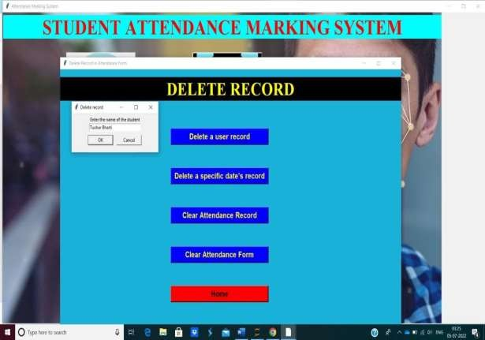

Slide 16
Working of Attendance Marking Algorithm:-
(We have used OpenCV library of python and imported face-recognition module to run our algorithm. The face-recognition module has some inbuilt functions which will find us the best match facial image from the existing list of 'Images DataSet' with the live WebCam image and update 'P' in the 'date' column with respect to that person's name )
Face encodings() function will encode all faces present in dataset and we
will store it in list of objects.
Face dis() is another one function which will take webCam image as parameter and will give us a numerical value of how much a webCam image is different from the list of known images(Images dataset).
Lesser the value,more accurate our webcam image would be identical to the image present in image train dataset.
As this function returns a numpy array of numerical values (numerical
value for each matching process ),
we just need to print the name of that image which has the least value in that numpy array.
Requirements for algorithm –
Images Dataset and (WebCam or Images Testing Dataset)
User input to take attendance (Button for clicking "Start Attendance")
User will also give current date of attendance marking to display the
column name(date) at the top.
and time to close the camera so late entries and absentees can be marked absent.
Purpose -
Student will be identified as 'P' or 'A' on the basis of existing data and the result will be transferred to update CSV file.

Slide 17
Managing a CSV file to store updated Attendance data:
When user will click 'Start Attendance' button,Attendance marking algorithm will run and mark attendance of persons and store it in a CSV file.
We have to update CSV file(basically attendance of students) in real time after each face recognition , for example, if person 'X' is identified as 'P' ,we will update our csv file by marking 'P' in 'date' column with respect to X's column and the process continues for each person present on that date and the time uptill which the form/webcam remains open.
Requirements –
Attendance marking algorithm to identify for which name our
column needs to be updated.('P' or 'A')
Current date to update the respective 'date' column.
Purpose –
To store data in database(CSV file) and perform some operations such as arranging names in ascending order after registration of each new entry.
deleteDate() function to remove any specific 'date' column in table.
clearAttendanceForm() function to clear all records in file except names.
clearAll() function to clear whole csv file.
deleteName() function to remove any specific row (deleting all records of a person)

Slide 18
This is how CSV file will look like after
adding some records into it :-
Name | | 29-06-2022 | | | 28-06-2022 | 26-06-2022
Anish | | P | | A | | P
Kritika | | P | | P | | A
Likhita | | A | | P | | P
Mehvish | | P | |  | A | A
Siddharth | | A | |  | A | P
Tush(both)| | A | |  | A | A
Usman | P
|
P |
P

Slide 19
Testing and validation check:
Registering new user
Marking attendance

Slide 20
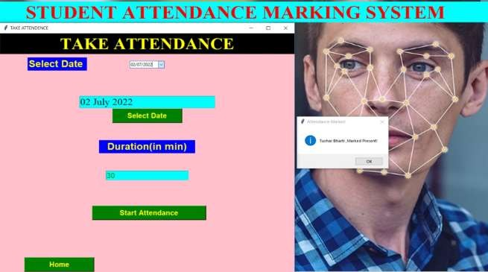
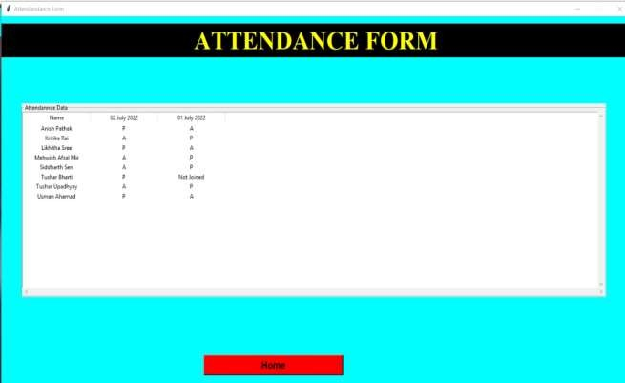
End result:

Slide 21
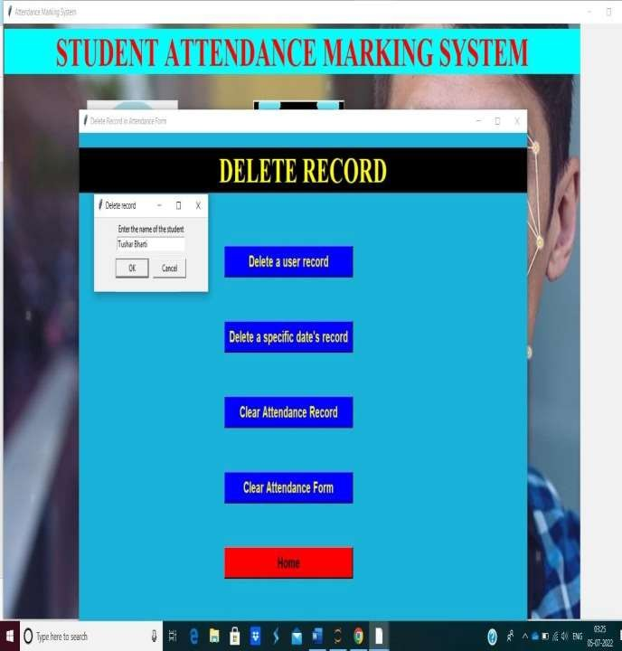
Deleting data of a user

Slide 22

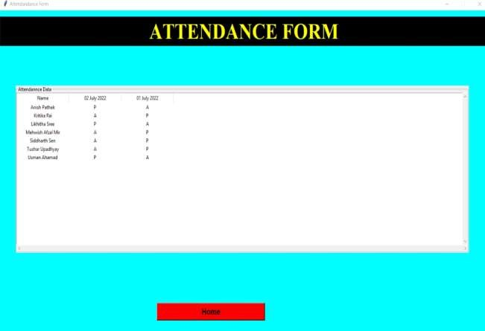
End result:

Slide 23
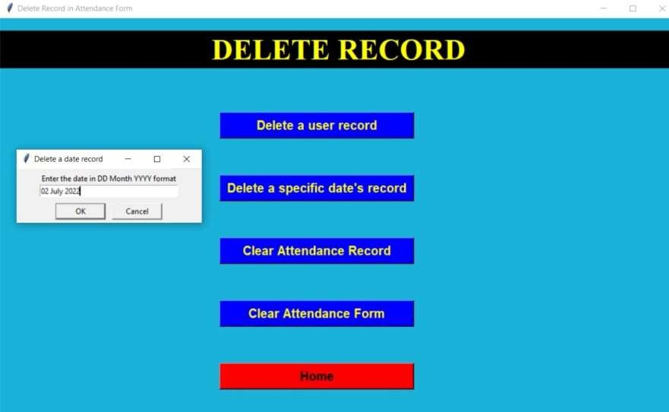
Deleting records of a date

Slide 24

End result:

Slide 25
Code:
from tkinter import*
from tkinter import ttk import PIL from PIL import Image,ImageTk
import tkinter as tk from tkinter import *
from tkinter import messagebox from tkcalendar import Calendar
from tkcalendar import DateEntry import csv import cv2
import pandas as pd
import numpy as np
import face_recognition as face_rec import os
import pyttsx3
import time
from datetime import datetime
from tkinter.simpledialog import askstring
from tkinter.messagebox import showinfo
def register():
def takePhoto(name):
with open('Attendance.csv','a',newline='') as f:
writer = csv.writer(f) writer.writerow([name])

Slide 26
df = pd.read_csv('Attendance.csv')
df=df.sort_values(by=['Name']) df.fillna('Not Joined',inplace = True)
df.to_csv('Attendance.csv',index = False)
voice = pyttsx3.init()
flag = False
cap = cv2.VideoCapture(0)
start_time = time.time() while True:
ret, frame = cap.read() cv2.imshow('img', frame)
key = cv2.waitKey(1)
if(flag == False and (time.time()-start_time>4)):
voice.say("Press 'Enter', to capture the image") voice.runAndWait() flag=True
#messagebox.showinfo("Message" ,"Press 'Enter' to capture the image") #flag = True
if key==13:

Slide 27
img_name = "TrainedImages/{}.jpg".format(name)
cv2.imwrite(img_name, frame)
voice.say("{}'s Image Succesfully Saved!".format(name)) voice.runAndWait()
messagebox.showinfo("Image Saved", "{}'s Image Succesfully Saved!".format(name)) root.destroy()
break
if key==ord('q'): break
cap.release()
cv2.destroyAllWindows()
root=tk.Tk()
root.geometry("1390x790") root.title("Register New Entry")
root['bg']="cyan"
title_lbl=Label(root,text="REGISTER NEW ENTRY",font=("times new roman",35,"bold"),bg="black",fg="yellow")
title_lbl.place(x=0,y=15,width=1390,height=60)
main_frame=Frame(root,bd=2) main_frame.place(x=150,y=150,width=670,height=430)

Slide 28
class_student_frame=LabelFrame(main_frame,bd=2,relief=RIDGE,text="Class Student information",font=("times new roman",12,"bold"))
class_student_frame.place(x=30,y=50,width=600,height=350)
student_name_label=Label(class_student_frame,text="Student Name:",font=("times new roman",12,"bold"))
student_name_label.place(x=20,y=50,width=250,height=30)
studentId_entry=ttk.Entry(class_student_frame,width=20,font=("times new roman",12,"bold")) studentId_entry.place(x=240,y=50,width=240,height=30)
btn_frame=Frame(class_student_frame,bd=2,relief=RIDGE,bg="white")
btn_frame.place(x=200,y=200,width=200,height=35)
save_btn=Button(btn_frame,text="Capture Image",width=21,font=("times new roman",12,"bold"),command=lambda:takePhoto(studentId_entry.get()),bg="yellow",fg="black")
save_btn.grid(row=0,column=1,padx=2)
root.mainloop()

Slide 29
def takeAttendance():
def startAttendance(date,time1):
df = pd.read_csv("Attendance.csv") df.insert(1,date,'') df.to_csv("Attendance.csv",index=False)
engine = pyttsx3.init()
def resize(img, size) :
width = int(img.shape[1]*size) height = int(img.shape[0] * size)
dimension = (width, height)
return cv2.resize(img, dimension, interpolation= cv2.INTER_AREA)
path = 'TrainedImages' studentImg = [] studentName = []
myList = os.listdir(path) for cl in myList : if(os.path.splitext(cl)[1]!='.jpg'):
continue

Slide 30
curimg = cv2.imread(f'{path}/{cl}') studentImg.append(curimg) studentName.append(os.path.splitext(cl)[0])
def findEncoding(images) :
imgEncodings = [] for img in images :
img = resize(img, 0.50)
img = cv2.cvtColor(img, cv2.COLOR_BGR2RGB) encodeimg = face_rec.face_encodings(img)[0]
imgEncodings.append(encodeimg) return imgEncodings
def MarkAttendence(name):
df = pd.read_csv('Attendance.csv')
l=df.index[df['Name']==name].tolist() if(df.at[l[0],date]!='P'):
statment = str(name + ", "+ " you are " + " marked present") engine.say(statment) engine.runAndWait()
#messagebox.showinfo("Attendance Marked" ,"{} ,Marked Present!".format(name))
df.at[l[0],date]= 'P' df.to_csv('Attendance.csv',index = False)

Slide 31
EncodeList = findEncoding(studentImg)
start_time = time.time()
vid = cv2.VideoCapture(0)
while True :
success, frame = vid.read()
Smaller_frames = cv2.resize(frame, (0,0), None, 0.25, 0.25)
facesInFrame = face_rec.face_locations(Smaller_frames)
encodeFacesInFrame = face_rec.face_encodings(Smaller_frames, facesInFrame)
for encodeFace, faceloc in zip(encodeFacesInFrame, facesInFrame) : matches = face_rec.compare_faces(EncodeList, encodeFace) facedis = face_rec.face_distance(EncodeList, encodeFace) matchIndex = np.argmin(facedis)
if matches[matchIndex] :
name = studentName[matchIndex] y1, x2,
y2, x1 = faceloc
y1, x2, y2, x1 = y1*4, x2*4, y2*4, x1*4 cv2.rectangle(frame, (x1, y1), (x2, y2), (0, 255, 0), 3)
cv2.rectangle(frame, (x1, y2-25), (x2, y2), (0, 255, 0), cv2.FILLED)
cv2.putText(frame, name, (x1+6, y2-6), cv2.FONT_HERSHEY_COMPLEX, 1, (255, 255, 255),2)
MarkAttendence(name)

Slide 32
cv2.imshow('video',frame)
key = cv2.waitKey(1)
if (key==ord('q') or (time.time() - start_time) > time1): df=pd.read_csv('Attendance.csv')
df.fillna('A',inplace=True) df.to_csv('Attendance.csv',index = False)
break
vid.release() cv2.destroyAllWindows()
root = tk.Tk()
root.title("TAKE ATTENDENCE") root.geometry("800x700")
root['bg']="pink"
title_lbl=Label(root,text="TAKE ATTENDANCE",font=("times new roman",35,"bold"),bg="black",fg="yellow")
title_lbl.place(x=0,y=0,width=800,height=60)
date_label = tk.Label(root, text = 'Select Date ', font=('calibre',20, 'bold'),bg="blue",fg="yellow").place(x=75,y=70)
cal = Calendar(root, selectmode = 'day',date_pattern='dd/mm/yyyy')

Slide 33
cal=DateEntry(root,selectmode='day',date_pattern='dd/mm/yyyy')
cal.pack(pady = 80)
date = tk.Entry(root, font=("times new roman",20),bg="cyan", width ='26')
date.pack(pady = 1)
def grad_date():
dt= cal.get_date() str_dt=dt.strftime("%d %B %Y")
date.delete(0,END) date.insert(0,str_dt)
Button(root, text = "Select Date",font =( 'calibre 15 bold'),
command = grad_date,bg="green",fg="yellow",width=15).pack(pady = 0)
Duration_label = tk.Label(root, text = ' Duration(in min) ', font=('calibre',20, 'bold'),width=15,bg="blue",fg="yellow")
Duration_label.pack(pady = 50)
Duration_entry = tk.Entry(root, font=('calibre',15,'normal'),bg="cyan",fg="green",width=20) Duration_entry.pack(pady = 1)
Button(root, text = "Start Attendance", font = 'calibre 15 bold',command = lambda:startAttendance(date.get(),int(Duration_entry.get())*60) ,width
=25,bg="green",fg="yellow").place(x=250, y=500)

Slide 34
Button(root, text = "Home", font = 'calibre 15 bold', width
=15,bg="green",fg="yellow",command=root.destroy).place(x=66, y=650)
root.mainloop()
def view():
def clear_data(): tv1.delete(*tv1.get_children()) return None
root = tk.Tk() root.title("Attendandance Form")
root.geometry("1400x800") root.pack_propagate(False) root.resizable(0, 0)
root['bg']="cyan"
frame0 = tk.Label(root,text="ATTENDANCE FORM",font=("times new roman",40,"bold"),bg="black",fg="yellow")
frame0.place(x=0,y=15,width=1400,height=70)

Slide 35
frame1 = tk.LabelFrame(root, text="Attendannce Data")
frame1.place(x=45,y=180,height=400, width=1300)
tv1 = ttk.Treeview(frame1)
tv1.place(relheight=1, relwidth=1)
treescrolly = tk.Scrollbar(frame1, orient="vertical", command=tv1.yview) treescrollx = tk.Scrollbar(frame1, orient="horizontal", command=tv1.xview) tv1.configure(xscrollcommand=treescrollx.set, yscrollcommand=treescrolly.set) treescrollx.pack(side="bottom", fill="x")
treescrolly.pack(side="right", fill="y")
excel_filename = r"C:\Users\bhart\OneDrive - Lovely Professional University\Documents\PythonCode\Face Recognition System\Attendance.csv"
df = pd.read_csv(excel_filename)
clear_data()
tv1["column"] = list(df.columns) tv1["show"] = "headings"
for col in tv1["columns"]:
tv1.column(col,anchor=tk.CENTER,stretch=tk.NO,width=150) tv1.heading(col, text=col)
df_rows = df.to_numpy().tolist()

Slide 36
for row in df_rows:
tv1.insert("", "end", values=row)
Button(root, text = "Home", font = 'arial 15 bold', command = root.destroy, width
=25,bg="red",fg="black").place(x=450, y=700)
root.mainloop()
def delete():
root = Tk()
root.geometry('1080x680') root.resizable(9, 1) root.config(bg = '#1BB1D9')
root.title('Delete Record in Attendance Form')
title_lbl=Label(root,text="DELETE RECORD",font=("times new roman",35,"bold"),bg="black",fg="yellow")

Slide 37
title_lbl.place(x=0,y=20,width=1080,height=60)
def deleteUserRecord():
name = askstring('Delete record', 'Enter the name of the student')
df = pd.read_csv("Attendance.csv", index_col ="Name" ) df.drop([name],inplace=True)
df.to_csv("Attendance.csv") os.remove(r"C:\Users\bhart\OneDrive - Lovely Professional
University\Documents\PythonCode\Face Recognition System\TrainedImages\{}.jpg".format(name))
messagebox.showinfo("Deleted","Record deleted successfully!")
root.destroy()
def deleteDateRecord():
date = askstring('Delete a date record', 'Enter the date in DD Month YYYY format')
df = pd.read_csv("Attendance.csv", index_col ="Name" ) df=df.drop([date], axis = 1) df.to_csv("Attendance.csv")
messagebox.showinfo("Deleted","Record deleted successfully!") root.destroy()
def clearAttendanceData():
df = pd.read_csv("Attendance.csv" )
df1=df['Name'] df1.to_csv("Attendance.csv",index=False)
messagebox.showinfo("Deleted","Record deleted successfully!") root.destroy()
def clearAllRecords():

Slide 38
with open('Attendance.csv','w') as f:
writer=csv.writer(f) writer.writerow(['Name'])
dir = r"C:\Users\bhart\OneDrive - Lovely Professional University\Documents\PythonCode\Face Recognition System\TrainedImages"
for f in os.listdir(dir):
if(f[-4:]=='.jpg'): os.remove(os.path.join(dir, f))
messagebox.showinfo("Deleted","Record deleted successfully!") root.destroy()
Button(root, text = "Delete a user record", font = 'arial 15 bold', command = deleteUserRecord, width =25,bg="blue",fg="yellow").place(x=350, y=150)
Button(root, text = "Delete a specific date's record", font = 'arial 15 bold', command
= deleteDateRecord, width =25,bg="blue",fg="yellow").place(x=350, y=250)
Button(root, text = "Clear Attendance Record", font = 'arial 15 bold', command
= clearAttendanceData, width =25,bg="blue",fg="yellow").place(x=350, y=350)
Button(root, text = "Clear Attendance Form", font = 'arial 15 bold', command = clearAllRecords, width =25,bg="blue",fg="yellow").place(x=350, y=450)
Button(root, text = "Home", font = 'arial 15 bold', command = root.destroy, width
=25,bg="red",fg="black").place(x=350, y=550)

Slide 39
root.mainloop()
root=tk.Tk()
root.geometry("1530x790+0+0") root.title("Attendance Marking System")
img=PIL.Image.open(r"GUI Images\HomePage.jpg") img=img.resize((1390,790),PIL.Image.ANTIALIAS) photoimg=ImageTk.PhotoImage(img)
bg_img=Label(root,image=photoimg)
bg_img.place(x=0,y=0,width=1390,height=790)
title_lbl=Label(bg_img,text="STUDENT ATTENDANCE MARKING SYSTEM",font=("times new roman",40,"bold"),bg="cyan",fg="red")
title_lbl.place(x=0,y=5,width=1390,height=60)
img1=PIL.Image.open(r"GUI Images\s1.png")
img1=img1.resize((220,220),PIL.Image.ANTIALIAS) photoimg1=ImageTk.PhotoImage(img1)
b1=Button(bg_img,image=photoimg1,command = register,cursor="hand2") b1.place(x=200,y=100,width=220,height=220)

Slide 40
b1_1=Button(bg_img,text="Register New Entry",cursor="hand2",font=("times new roman",15,"bold"),command=register,bg="black",fg="yellow")
b1_1.place(x=200,y=300,width=220,height=40)
img2=PIL.Image.open(r"GUI Images\att.png") img2=img2.resize((220,220),PIL.Image.ANTIALIAS)
photoimg2=ImageTk.PhotoImage(img2)
b2=Button(bg_img,image=photoimg2,command = takeAttendance,cursor="hand2") b2.place(x=600,y=100,width=220,height=220)
b2_1=Button(bg_img,text="Take Attendance",command = takeAttendance,cursor="hand2",font=("times new roman",15,"bold"),bg="black",fg="yellow")
b2_1.place(x=600,y=300,width=220,height=40)
img4=PIL.Image.open(r"GUI Images\td.jpg")
img4=img4.resize((220,220),PIL.Image.ANTIALIAS) photoimg4=ImageTk.PhotoImage(img4)
b4=Button(bg_img,image=photoimg4,command=view,cursor="hand2") b4.place(x=200,y=400,width=220,height=220)
b4_1=Button(bg_img,text="View Attendance",command = view,cursor="hand2",font=("times new roman",15,"bold"),bg="black",fg="yellow")
b4_1.place(x=200,y=600,width=220,height=40)

Slide 41
img5=PIL.Image.open(r"GUI Images\delete.jpg") img5=img5.resize((220,220),PIL.Image.ANTIALIAS)
photoimg5=ImageTk.PhotoImage(img5)
b5=Button(bg_img,image=photoimg5,command = delete,cursor="hand2") b5.place(x=600,y=400,width=220,height=220)
b5_1=Button(bg_img,text="Delete",command = delete,cursor="hand2",font=("times new roman",15,"bold"),bg="black",fg="yellow")
b5_1.place(x=600,y=600,width=220,height=40)
root.mainloop()

Slide 42
Conclusion:
Before the development of this project. There were many loopholes in the process of taking attendance using the old method which caused many troubles to most of the institutions. Therefore, the facial recognition feature embedded in the attendance monitoring system can not only ensure attendance to be taken accurately and also eliminated the flaws in the previous system. By using technology to conquer the defects cannot merely save resources but also reduces human intervention in the whole process by handling all the complicated task to the machine. The only cost to this solution is to have sufficient space in to store all the faces into the database storage. Fortunately, there is such existence of micro-SD that can compensate with the volume of the data. In this project, the face database is successfully built. Apart from that, the face recognizing system is also working well.At the end, the system not only resolve troubles that exist in the old model but also provide convenience to the user to access the information collected by mailing the attendance sheet to the respected faculty.

Slide 43
Future scope of improvement:
We certainly do hope to expand and introduce new and enhanced versions of this attendance marking system as current project is only built with the fundamental functionality and features.
Some likely developments in this programme can be:
Better user interface (UI) experiences
further functionality for database manipulation and record extraction
processing enormous amounts of data
arranging the names, discovering present percentage,identifying faces correctly with more better accuracy etc.,

